Slide 1
Dalton Public Schools
ESOL Department
Kindergarten “Green Folder” Paperwork
Scanner Training
Created by Kimberly Rhyne
12.31.13
www.free-ppt-templates.com

Slide 2
Sit back & enjoy
You will receive an email with a link to this presentation. So, don’t worry about taking notes (unless you want to). Sit back and enjoy the presentation.

Slide 3
Video tutorial links
This link will take you to some YouTube video tutorials. It is the first of 18 videos on different topics related to our scanners. The videos are short and informative.
http://www.youtube.com/watch?v=k43cUxGbfqc&list=PL7D37251EF4D6A691&safe=active

Slide 4
A few odds & ends
  There are a few things you need to know about the scanners:
  They scan 40 single sided pages a minute which is equal to 20 double sided pages.
  If a part of your scanner breaks, keep all parts to simplify the replacement process.
  The scanners will orient pages (as needed).
  They will also auto correct if a paper is scanned upside down.
  It will delete blank pages.
  You can scan different sizes and types of paper.
  If you have a damaged document, then use the film provided to scan the document (slip it in the film and scan).
  If you have highlighted something and the marker bled through to the other side, the scanner will pick it up and scan it as a page.

Slide 5
Paperwork Order
Home Language Survey
  If you don’t have this form, then make sure Infinite Campus (IC) is updated in the language section.
W-APT Summary
  Do not include the answers…just the summary.
Initial Referral form
Parent Notification Letter
TPC (testing accommodations) form

Slide 6

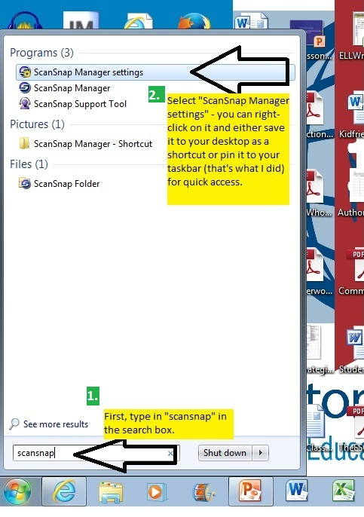
ScanSnap Manager
First, find your “ScanSnap Manager settings” so you can get everything set up correctly.
This picture shows you how to search for it.
I would suggest saving it to your desktop as a shortcut or pin it to your taskbar so it is always just one click away.

Slide 7
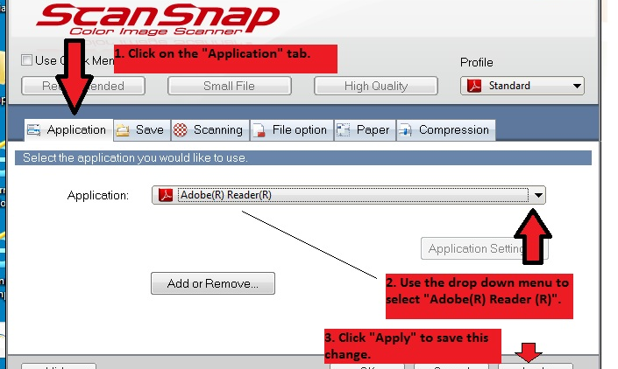
Application tab
Click on the “Application” tab
Use the drop down menu to select “Adobe® Reader ®
Click “Apply” to save this change. (IMPORTANT!!!)

Slide 8
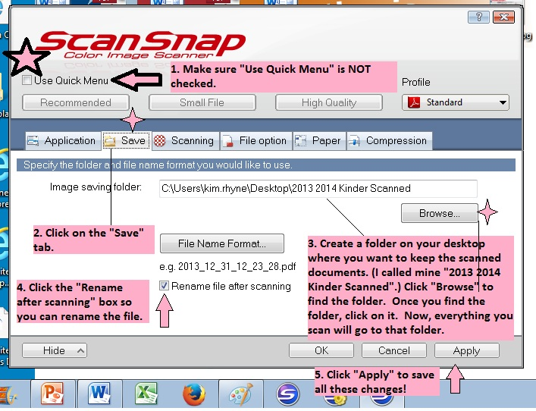
Save tab
Make sure “Use Quick Menu” is NOT checked.
Click on the “Save” tab.
Select the folder to house your images.
Click the “Rename” box
Click “Apply”!!!

Slide 9
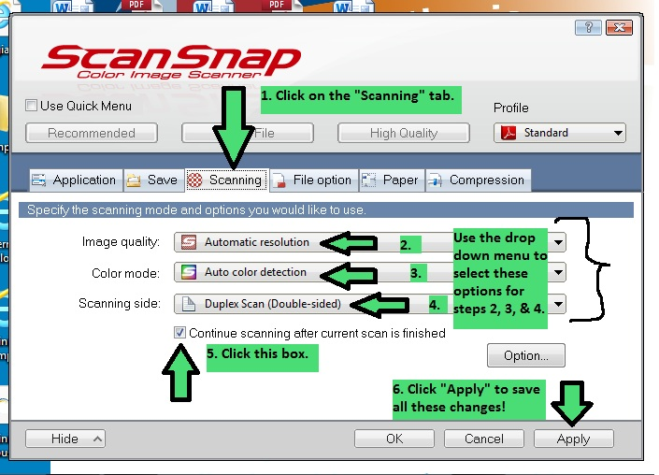
Scanning tab
Click on the “Scanning” tab.
2-4. Select the options as shown.
Click the “Continue scanning…” box
Click “Apply”!!!

Slide 10
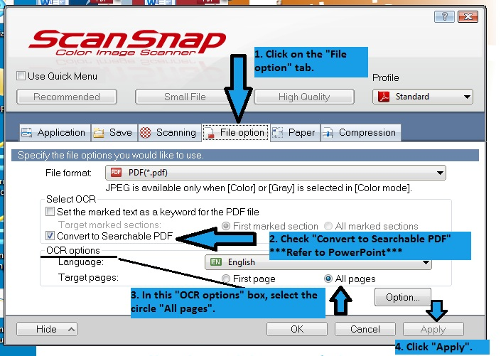
File Option
Click on the “File option” tab.
Check “Convert to Searchable PDF” – When you select this and save, a pop up box will appear and ask you if this is what you want. Just click the “Yes, I understand” box. ☺
Select “All pages” in the OCR options box
Click “Apply”!!!

Slide 11
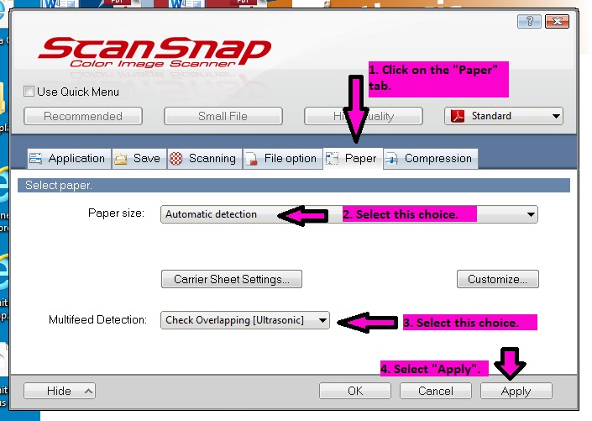
Paper tab
Select the “Paper” tab
2-3. Select the options as shown.
4. Select “Apply”!!!

Slide 12
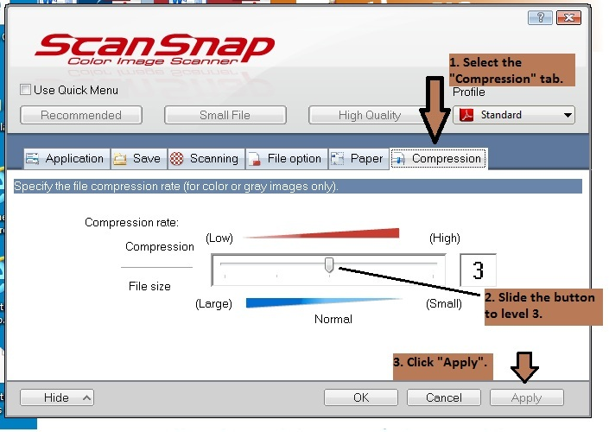
Compression tab
Select the “Compression” tab
Slide the button to level 3
Click “Apply”!!!

Slide 13
Begin scanning
Lift the top panel of the scanner
Insert papers face down
Press blue “Scan” button on the scanner

Slide 14
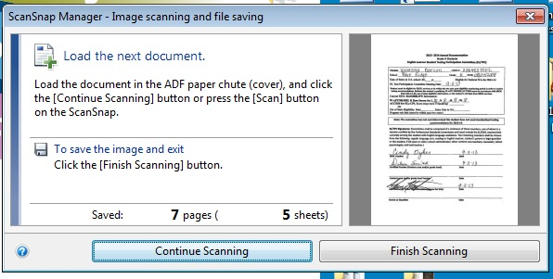
This screen will pop up when you are scanning:
Click finish scanning after you scan the paperwork for each student. If not, then the papers will all scan as one document and you will not be able to upload documents for each student in IC.

Slide 15
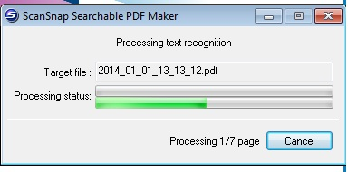
This screen will pop up next:
This takes a couple of seconds…just sit patiently and wait for it to finish. ☺

Slide 16
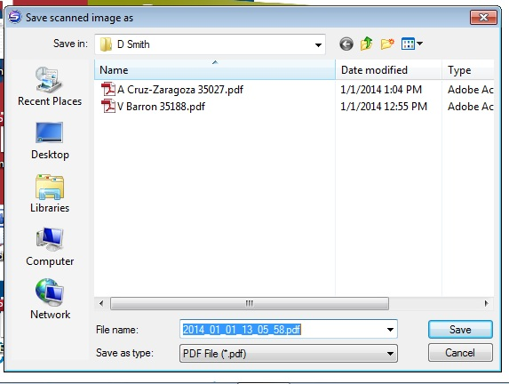
Time to save your documents:
This screen will pop up – you will want to change the file name to something you can recognize (next slide).

Slide 17
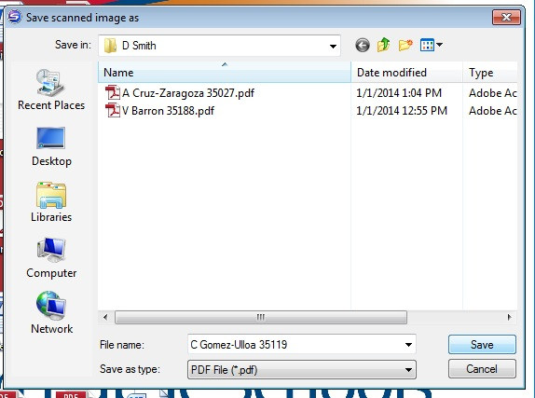
Change the file name:
I use the first name initial, last name, and the 5 digit student ID number (in case some students have the same of similar names).
I have a folder for each Kindergarten teacher so I can save the files for their students in their folder. It helps when I upload them to IC.

Slide 18
Upload time
Open up and log into Infinite Campus.

Slide 19
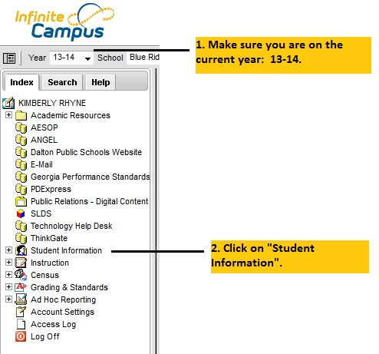
Infinite Campus
Make sure you are on the current year: 13-14
Click on Student Information

Slide 20
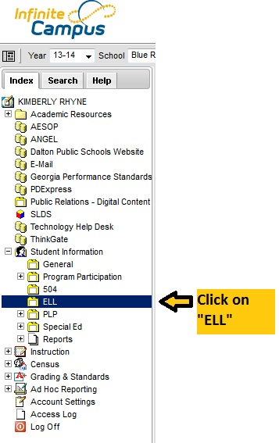
Infinite Campus
Click on “ELL”

Slide 21
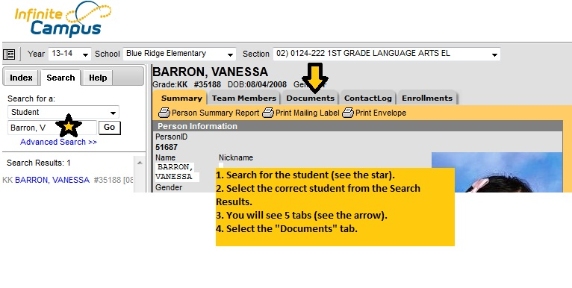
Documents tab
Search for the student (in the search box where the star is).
Select the correct student from the “Search Results”
You will see 5 tabs: Summary, Team Members, Documents, Contact Log, and Enrollments.
Select the “Documents” tab.

Slide 22
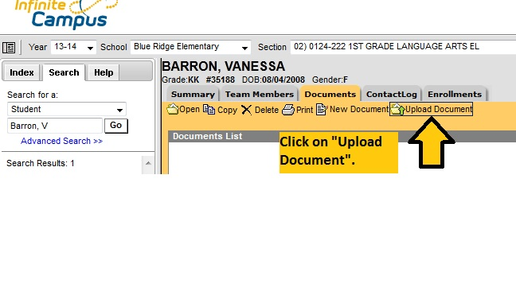
Upload Document
Click on “Upload Document”.

Slide 23
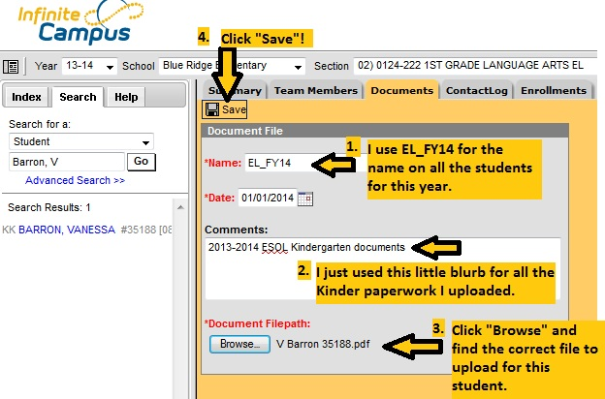
Document File information:
1. I use EL_FY14 for the name on all the students for this year.
Comments field: I put “2013-2014 ESOL Kindergarten documents”.
Click “Browse” and find the correct file to upload for this student.
Click Save!!! (VERY IMPORTANT)

Slide 24
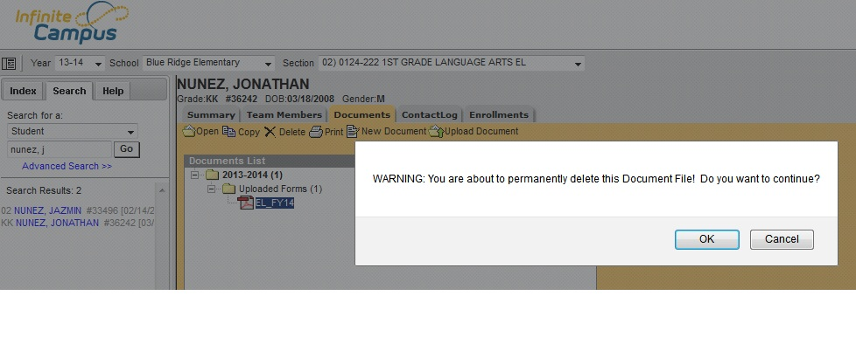
If you need to delete…
If you upload the wrong papers, you can select the file you uploaded and hit “delete. Just click “OK” when this box pops up on your screen.

Slide 25
Link to presentation
If you think of something I need to add to this presentation, then please let me know.
Here is the link for this presentation:
http://elstudents.weebly.com/presentations.html

